Slide 1
Designing a Group Major in Data Science
Deborah Nolan
University of California, Berkeley
data.berkeley.edu

Slide 2
Berkeley by the Numbers
30,000 undergraduates
22,000 in College of Letters & Sciences
5,000 do off-campus public service annually
30% Pell grant eligible
20% First generation
20% CC transfers

Slide 3
Alignment of Interests
Rapid Action Taskforce – campus-wide proposal for curriculum for making engagement with data an integral feature of education for all undergrads
D-Lab created for data intensive social science research
STAT Department APR strongly recommended DS (also 5 joint appointments with EECS)
CS - Intro to programming has 1800/semester

Slide 4
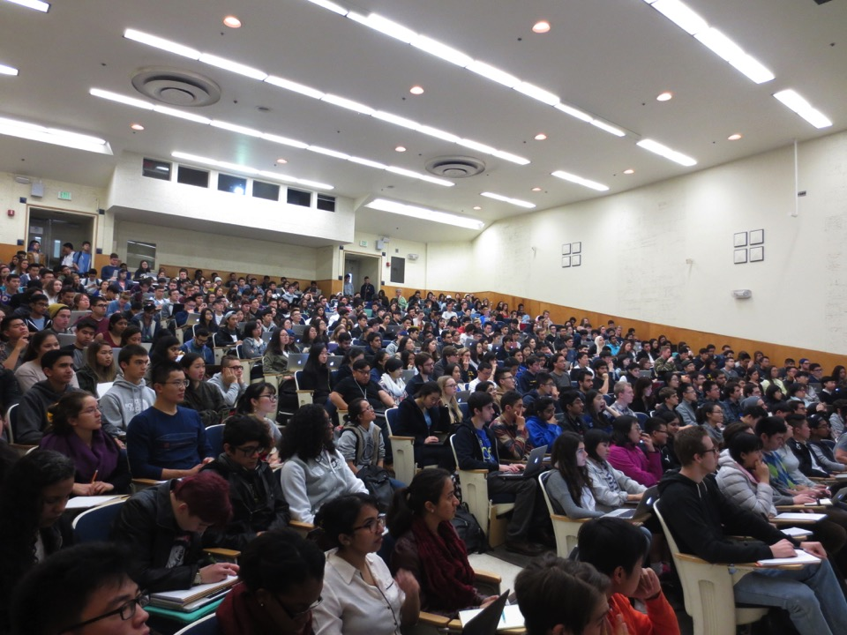
Foundations in Data Science
No math, stat, or CS pre-requisites
Data-hub: students work in browser
Basics in inference via simulation & bootstrap
Basics in computation
data8.org

Slide 5
Connectors Across Campus

Slide 6
Principles & Techniques of DS
Data life cycle
Data design & generalizability
Empirical risk minimization
Implications for large data (computational & inferential)
Basic data tools
www.ds100.org

Slide 7
Topics
Data preparation and representation
Exploratory data analysis & visualization
Model fitting and inference
Efficient and scalable data processing
www.ds100.org

Slide 8
Enrollment Growth
www.ds100.org

Slide 9
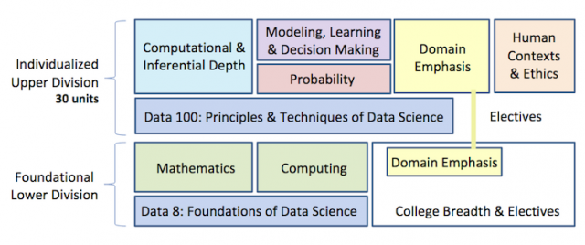
Data Science Group Major
data.berkeley.edu

Slide 10
Key Features of the Major
Human Contexts & Ethics
One dedicated course plus topics appears in other courses
Human & social structures and practices that shape data science activity
Many flavors of the course – taught by faculty in philosophy, information, law, business, history
data.berkeley.edu
Notes:
The aim of the HCE requirement is to equip students with an understanding of the human and social structures, formations, and practices that shape data science activity (such as data collection and analysis, data stewardship and governance, work to ensure privacy and security, deployment of data in societal or organizational settings, decision-making with data, engagements of data with justice, practices of data ethics) and to allow them to gain experience and practice with modes of critical thinking, reflection, and engagement with these experiences and the choices involved.

Slide 11

Key Features of the Major
Domain Emphasis
Need not be computationally oriented
Notes:
The aim of the HCE requirement is to equip students with an understanding of the human and social structures, formations, and practices that shape data science activity (such as data collection and analysis, data stewardship and governance, work to ensure privacy and security, deployment of data in societal or organizational settings, decision-making with data, engagements of data with justice, practices of data ethics) and to allow them to gain experience and practice with modes of critical thinking, reflection, and engagement with these experiences and the choices involved.

Slide 12
Key Features of the Major
Four core technical classes
Integrate computational and inferential thinking in all courses
Probability & Machine Learning have alternatives, but one version is specifically designed for major
data.berkeley.edu
Notes:
The aim of the HCE requirement is to equip students with an understanding of the human and social structures, formations, and practices that shape data science activity (such as data collection and analysis, data stewardship and governance, work to ensure privacy and security, deployment of data in societal or organizational settings, decision-making with data, engagements of data with justice, practices of data ethics) and to allow them to gain experience and practice with modes of critical thinking, reflection, and engagement with these experiences and the choices involved.

Slide 13
Discussion Points
Technical vs Soft topics
Breadth vs Depth
The CS Gorilla
The Future of the STAT major
Two cultures

Slide 14
What’s Next?
Machine learning course for major
Scale with a mind toward sound pedagogy
Set up Major governing board & MOUs with departments
Wait and see about impact on stat major
Better aligned math prerequisites

